Slide 1


Slide 2
Announcement
Attendance link will be shared at the end of the session
Minimum 25 Days Attendance required to receive your FREE E-CERTIFICATE (with same mobile number & email id)

Slide 3
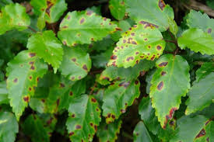
Leaf disease detection
Plant disease identification by visual way is more laborious task and at the same time less accurate and can be done only in limited areas.
Whereas if automatic detection technique is used it will take less efforts, less time and more accurately. In plants, some general diseases are brown and yellow spots, or early and late scorch, and other fungal, viral and bacterial diseases.

Slide 4
Block Diagram – Workflow of Image Classification CNN
Dataset Creation
Train, Test, Val
CNN Design
Pre-Processing
Training - Model
Load Model - Test
Pre-process Input Image
Classification

Slide 5
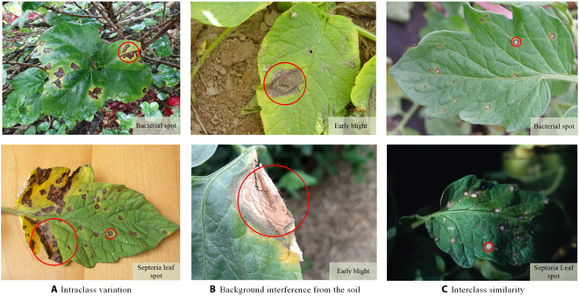
Ready For Hands On
Leaf disease detection using Deep Learning

Slide 6




THANK YOU☺
NOVITECH COIMBATORE
novitechresearchanddevelopment

Slide 7
Q & A Session?

